Slide 1
RECIPROCAL INFLUENCE OF PERSIAN AND INDIAN WOMEN’S COSTUME
Ms. Monisha Kumar
Dr. Amita Walia

Slide 2
Introduction
The present study contributes ‭ ‬to documentation‭ ‬ of‭ ‬ the traditional Persian‭ ‬ costumes‭ ‬ with‭ ‬ emphasis on its influence on the Indian costume ( Salwar Kameez) and vice versa.

Slide 3
Objectives
The objectives of the study are to:
Make an in-depth study of the ancient Indian women’s costume. ‬
Understand the Persian women’s costume during the medieval period.‬
Analyze the reciprocal influence of Persian and Indian women’s costume.‬

Slide 4
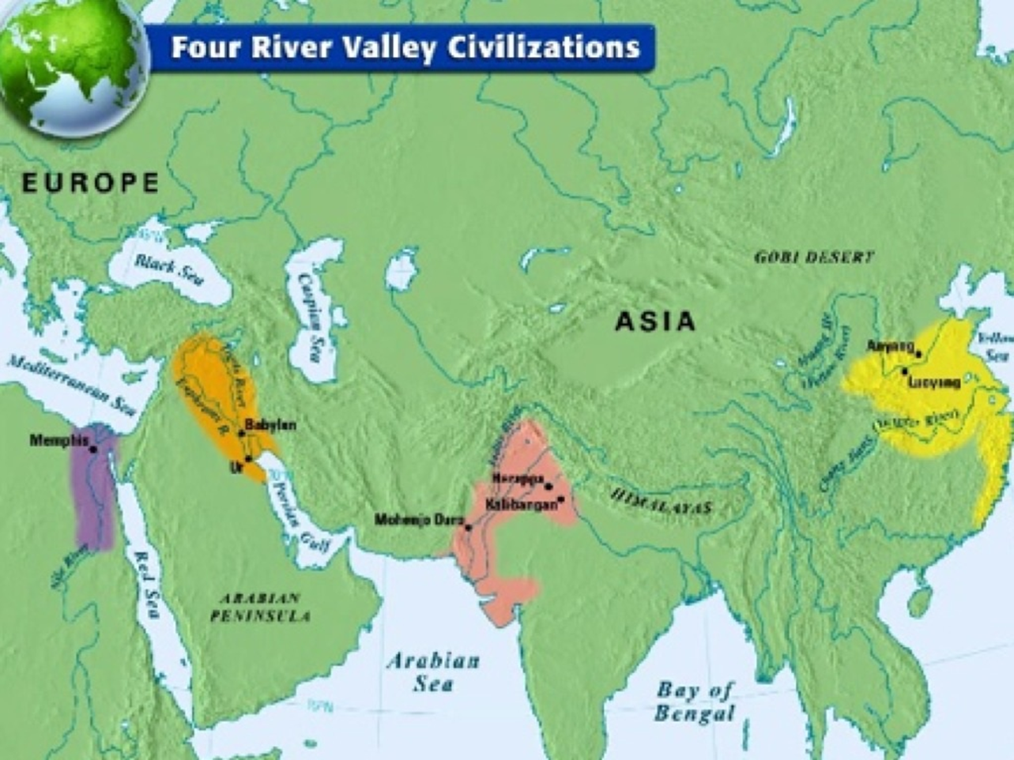
Source: http://distant-relatives-blog.tumblr.com/post/71053744162/four-river-valley-civilizations-nile

Slide 5
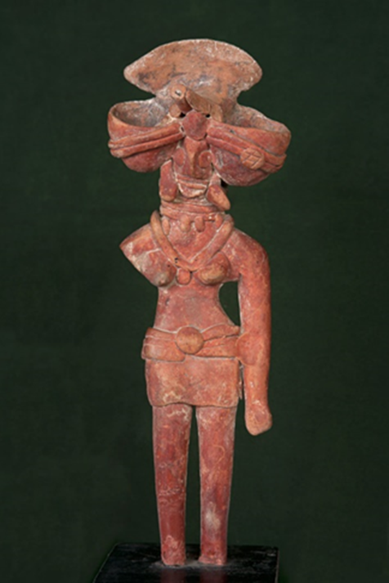
Costumes during the Ancient Times
‭Indus Valley‭ ‬‬
Mother Goddess of Mohenjo-Daro ‬‬
‭Mesopotamia‬
Costume of the Sumerians
Source:http://www.nationalmuseumindia.gov.in/prodCollections.asp?pid=34&id=1&lk=dp1
Source: http://womenfromthebook.com/category/sumerians/

Slide 6
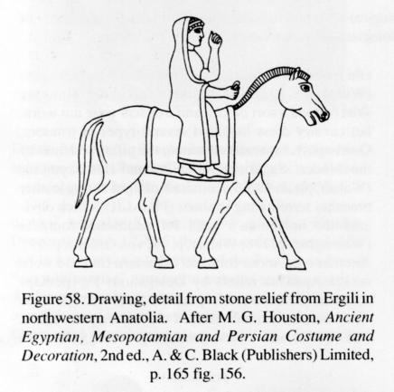
Persian Costume
Vedic & Post Vedic Period
Source: Alkazi, R. Ancient Indian Costume, 1983, New Delhi.
Source: Houston, M.G. Ancient Egyptian, Mesopotamian and Persia Costume and decoration, II edition, London.

Slide 7
Gupta Period
The Gupta period is known as the Golden Age or Classical Period in the history. Towards the end of Gupta Empire, cut and sewn garments were observed, but the royalty still used the draped garments especially for women (Alkazi, 1983).
Source: Alkazi, R. Ancient Indian Costume, 1983, New Delhi.

Slide 8
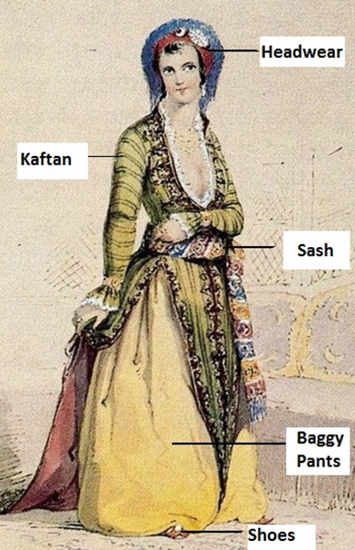
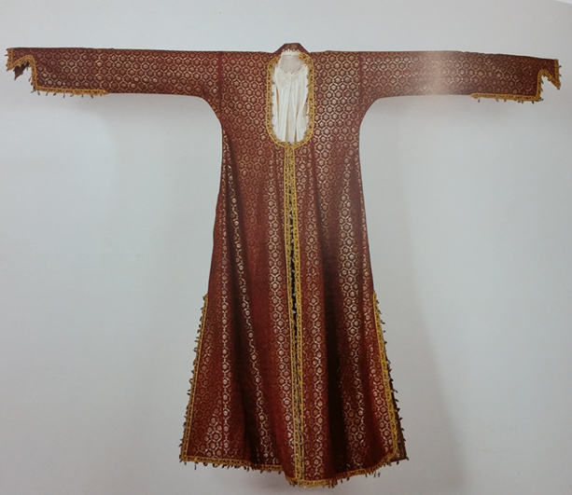
Persian Influence
Review of literature, have revealed that after 1100 AD when Ottoman was predominant in the Middle East & Slave Dynasty was establishing itself in Indian Subcontinent, both men and women wore ‘Kaftan’ originally a Persian garment. Salvar or trouser as a lower garment and turbans.
Women Costume of Slave Dynasty
Source: Kahlenberg, M.H. Asian Costumes and Textiles from the Bosphorus to Fujiyama, 2001, I edition, Italy.
Kaftan from Ottoman Empire

Slide 9
Even though the bifurcated and stitched garments were popularly worn during the slave dynasty, these costumes became more predominated and influenced by the impact of the Mughals.
With the Persian influence, the majority of stitched garments entered India; the Antariya was replaced by the Pajamas (Lower garment). The uttariya still remained though various tunics like Kurtas and angrakhas were added.
Source: http://strandofsilk.com/indian-fashion-blog/stylish-thoughts/flared-flair-designer-anarkalis

Slide 10
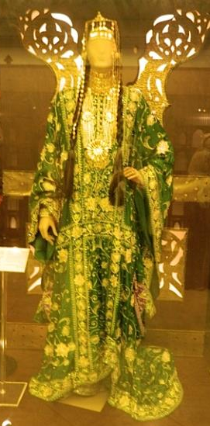
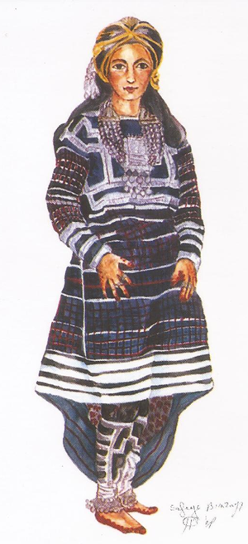
Traditional Arabic Costume
Source: Safia Binzagr Museum- Jeddah, KSA
Source: Center For Omani Dress, Muscat, Oman

Slide 11
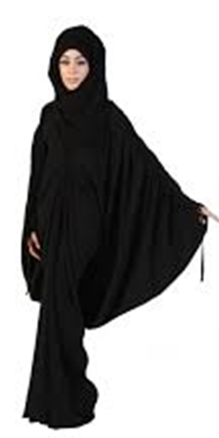
Present Status
Present young generation in the Middle East mostly wears western wear under the Abaya and wears Hijāb and the traditional clothes are only for occasions like weddings and festivals.
They look forward to the latest fashion of salwar kameez, now an important part of the women clothing in the Indian subcontinent, in the Bollywood movies and fashion shows.
Source: https://www.hialbarshadubai.com/blog/dubai/traditional-wear-in-the-uae/

Slide 12
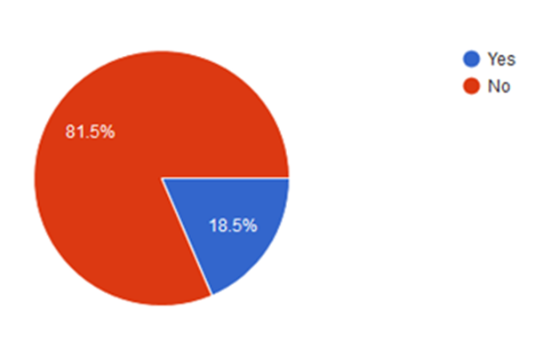
Origin of Salwar Kameez

Slide 13
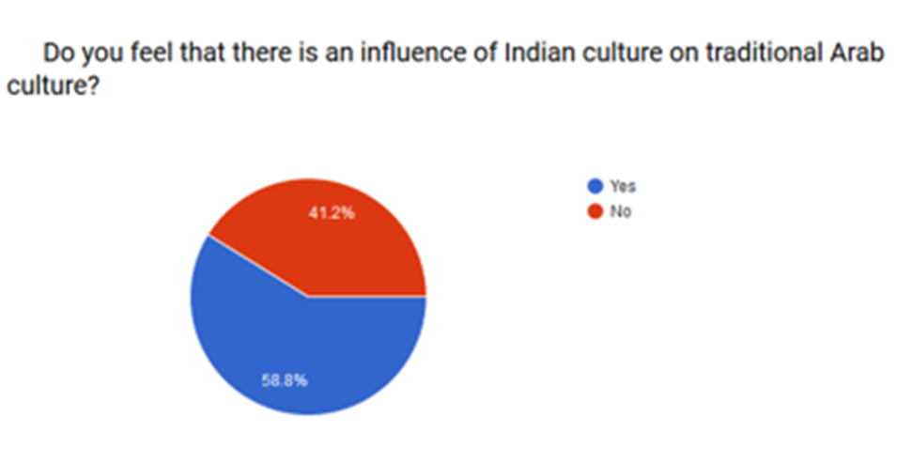
Reciprocal Influence

Slide 14
Conclusion
The cultural identity of any region can be depicted by Fashion and the garments worn by the natives of that region. There has been a considerable change in the cultural identity of both the Indian Subcontinent and the Middle Eastern countries popularly known as the Arab countries.
The study leaves a scope for the future upcoming designers of the Middle East to take pride in their traditional garments and try to revive them in more contemporary and fashionable way as daily or casual wear among the young generation.

Slide 15
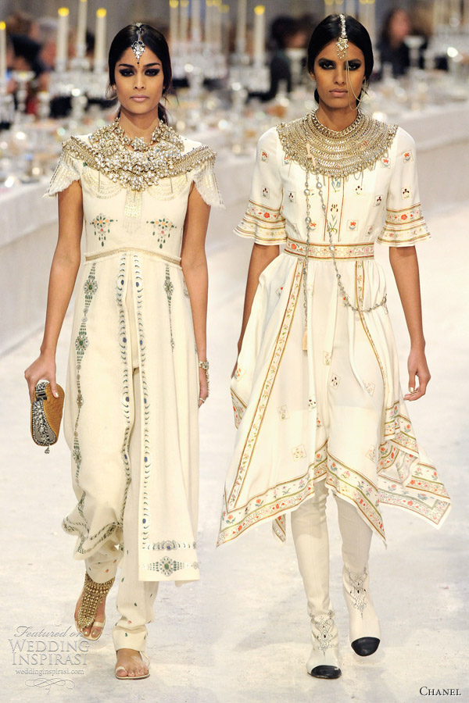
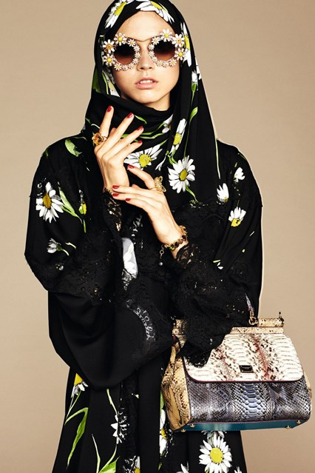
Designers Views
Indian Subcontinent
Middle East
Source: http://www.vogue.co.uk/news/2016/01/05/dolce-and-gabbana-hijab-and-abaya-collection/gallery/1535797
Source: http://www.weddinginspirasi.com/2012/01/06/chanel-pre-fall-2012-collection-paris-bombay/

Slide 16
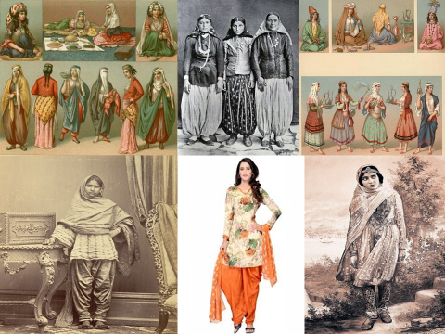
Thank You.

